Slide 1
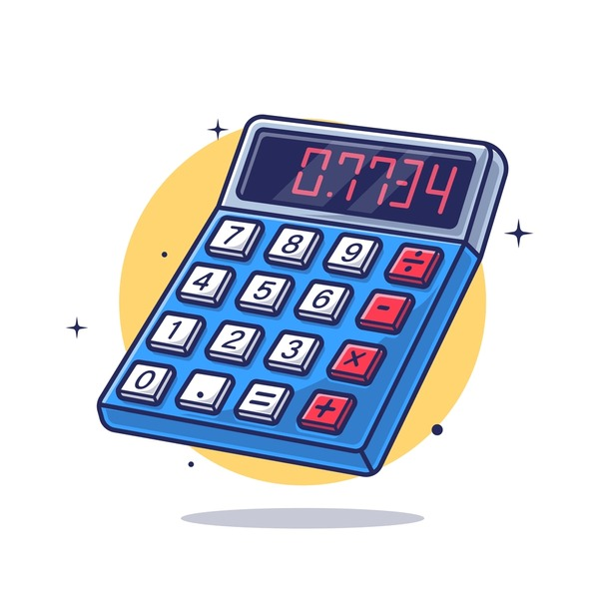
Calculator using Python.
Presented by:- Mr. Omkar V. Gosavi

Slide 2
Introduction:- Python is a popular programming language. It was created by Guide van Rossum, and released in 1991. It is used for:- Web development. Software development. Mathematics. System scripting.

Slide 3
About the Project:-
Calculator is basically a programme on a computer that simulates the behaviour of any hand-held calculator useful for performing mathematical calculations. It is a very basic device used in our everyday lives. Now all the smartphones also have a calculator application.

Slide 4
Making a calculator steps:- The calculator program will add up two numbers and then return the answer to the screen Extend the code so that it now multiplies, subtracts and divides the two numbers and displays the answer to each calculation on the screen at the same time. (use copy and paste to make this an easy task!) Extension Allow the user to input the two numbers to be used in the calculations (Hint you will need to convert the number to an integer – see here for more details Allow the user to input which arithmetic operator they want to use.

Slide 5
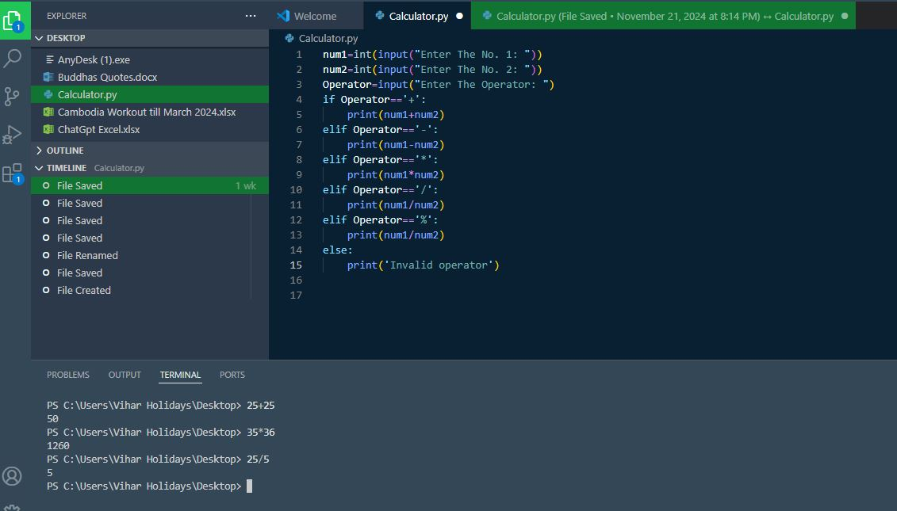
Output:-

Slide 6
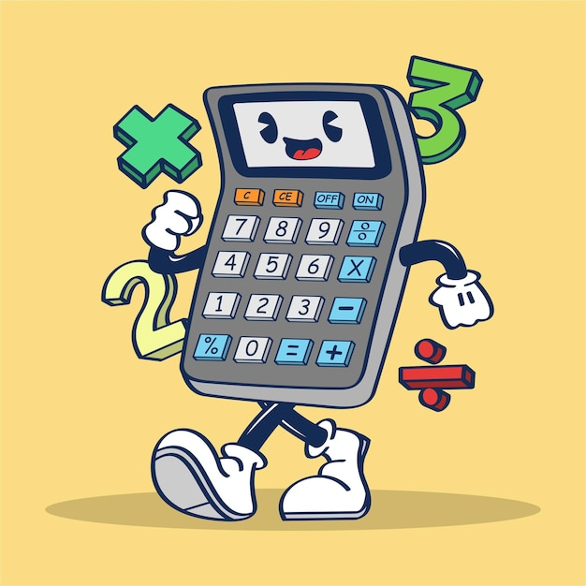
Thanks for watching….

